Slide 1
Cyber Threats, Loss Prevention and Claims
CP Insurance Associates – 2023 Conference
Drew Niermann, Brennan Duvall, Craig Mulligan • Travelers Bond & Specialty Insurance • 10/05/2023
Notes:
-Introduce yourself & the title of the call

Slide 2

This course is intended to provide general information about the subjects covered and are not intended as, nor do they constitute, legal or professional advice, nor are they an endorsement of any source cited, or information provided.
Any examples or discussions of coverages are about coverages generally available in the marketplace, and are not based specifically on the policies or products of Travelers. Coverage depends on the facts and circumstances involved in the claim or loss, all applicable policy or bond provisions, and any applicable law.
Claims scenarios are based on actual claims, composites of actual claims, or hypothetical situations. Resolution amounts are approximations of both actual and anticipated losses and defense costs. Facts may have been changed to protect confidentiality. Any examples or discussions of claim handling or processes are for illustrative purposes only. Every claim is unique and must be evaluated on its own merits.
Notes:
Legal Disclaimer

Slide 3

Agenda
Top threats & loss prevention
  Email compromise
  Ransomware
  Credential theft & failure to patch
Important concepts
By-the-numbers
Cyber claim themes
Cyber insurance
Notes:
Agenda Outline

Slide 4


Slide 5
Top threats:
Email compromise
Notes:
-Set stage about how you’ll help show how important a corporate email account is/how much can be done with it.
-Global nature of business, COVID move towards largely remote workforce
-

Slide 6


Email compromise
Web based email platforms are becoming more widely used
Once a fraudster has access to email, this access is used to perpetrate other crimes
Social engineering fraud (SEF)
Invoice manipulation
Computer fraud
Theft of personally identifiable information
In addition to any 1st party loss, Data Privacy laws require individuals whose confidential information was accessed within e-mails be notified
Notification costs | Forensic investigation | Legal fees
Notes:
Web based email platforms are becoming more widely used (ex: Microsoft Office 365 (O365)
Once a fraudster has access to email, this access is used to perpetrate other crimes
Social engineering fraud (SEF)-fraudsters like to use email based communications to attempt to get targets to change bank payment information/send out payments
Invoice manipulation-threat actor hacks into your business/takes over email account. Then threat actor starts emailing your customers/vendors/trading partners asking for payment (or products/inventory) & then your customer/vendor/partner sends either goods or payment to threat actor thinking it’s your company.
Computer fraud
Use of email as a “basecamp” to gain access to other web-based platforms such as payroll
Theft of personally identifiable information
In addition to any 1st party loss, Data Privacy laws require individuals whose confidential information was accessed within e-mails be notified
Notification costs, forensic investigation, legal fees

Slide 7
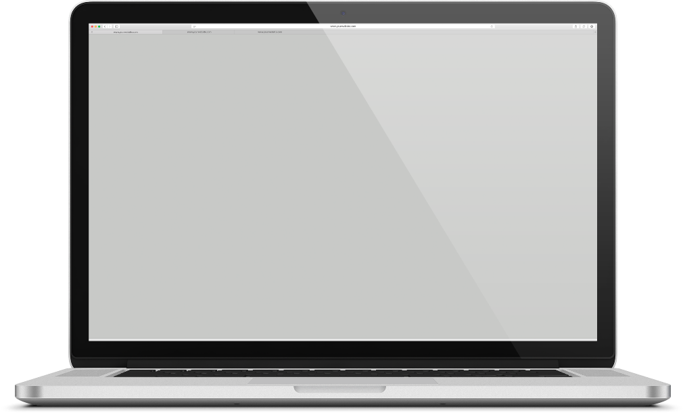
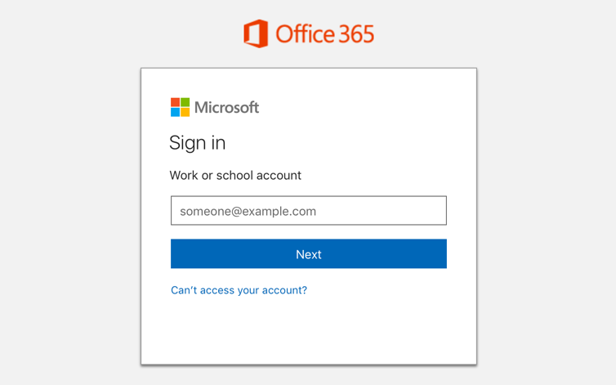
How does email compromise happen?
This login page is available from any computer, anywhere
Convenient for your workforce, but also convenient for cyber criminals
If a username and password are the only requirements to access email, anyone that obtains that information has full access
Threat actors (TA) have many sophisticated methods of obtaining this information
Notes:
-Stress that the ability to log into work email is now no longer something that is tethered to physically going into an office building. An employee can log into their work email from anywhere in the world as long as they have some sort of smartphone/laptop along with internet & web browser.
-This simple facts means that without proper controls in place, it is impossible to tell if the person logging in is the employee or some hacker intent on doing harm to a company.
-

Slide 8

How is login information obtained?
1
2
3
4
Emails with malicious links or tainted attachments; may recommend password change | Dark web acquisition of compromised emails addresses and passwords | Scouring of Facebook, LinkedIn and other social media sources | Emails from a misleading source with obscured or modified origin (ex: Amazoon.com)
Notes:
A review of company website (“About Us” or “Team/Management” or “Contact Us”) (TALK ABOUT HOW EASY IT IS TO GET
Emails with malicious links or tainted PDF attachments, Word documents, or Excel spreadsheets. Some emails may seem “IT-like” recommending changing of passwords though an accompanying link.
Once an attachment or link is clicked or login information is entered, an attack is likely.
Dark web acquisition of compromised emails addresses and passwords
Scouring of Facebook, LinkedIn, and other social media sources
Emails from a misleading source with obscured or modified origin. Example: Amazoon.com.

Slide 9
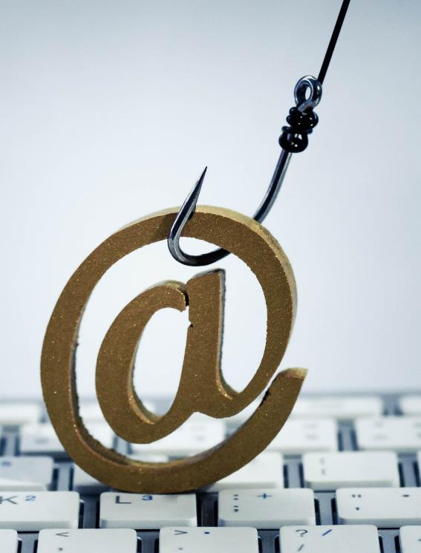
How are attacks initiated?
Email initiated cyber attacks can start in a number of ways:
Criminals alter settings for compromised account
TAs monitor email traffic to understand organizational structure, speech nuances, etc. to inflict maximum damage
Damage can come from accessing corporate intellectual property, databases, personnel files or customer and vendor information
Hackers make things more difficult by covering their tracks and deleting activity logs
Organizations vulnerable to these attacks tend to get hit repeatedly until vulnerability is addressed
Notes:
Email initiated cyber attacks can start in a number of ways:
Once a criminal has access to email they alter settings for the compromised account, including creating auto-forwarding rules so legitimate email owners cannot see incoming replies to fraudulent emails
TAs monitor email traffic to understand organizational structure, speech nuances, & other information to inflict maximum damage
Damage can come from accessing corporate intellectual property, databases, personnel files, or customer and vendor information (attacking vendors and customers in the name of the compromised organization which can lead to litigation), which can all be exfiltrated
Hackers make things more difficult by covering their tracks and deleting activity logs
Organizations vulnerable to these attacks tend to get hit repeatedly until vulnerability is addressed

Slide 10

Email Compromise Attack Chain EXAMPLE
TA obtains login credentials for email account
TA logs onto account and monitors traffic
TA modifies email auto-forwarding rules
TA initiates emails internally and externally
TA emails customer inquiring on payment of bill
TA mentions banking information has changed
Customer sends payment to fraudster’s bank
Authorized user asks customer about payment due
Customer indicates the bill has been paid
Authorized user realizes their account and possible corporate network are compromised
Notes:
*Auto forwarding rules: TA modifies these to send all emails first to junk inbox which most people don’t check. Any email that does not somehow involve a TA scam email chain can then be sent from junk to inbox in real time so authorized email user doesn’t notice the lack of email activity. Emails connected to TA activity remain in junk inbox.

Slide 11
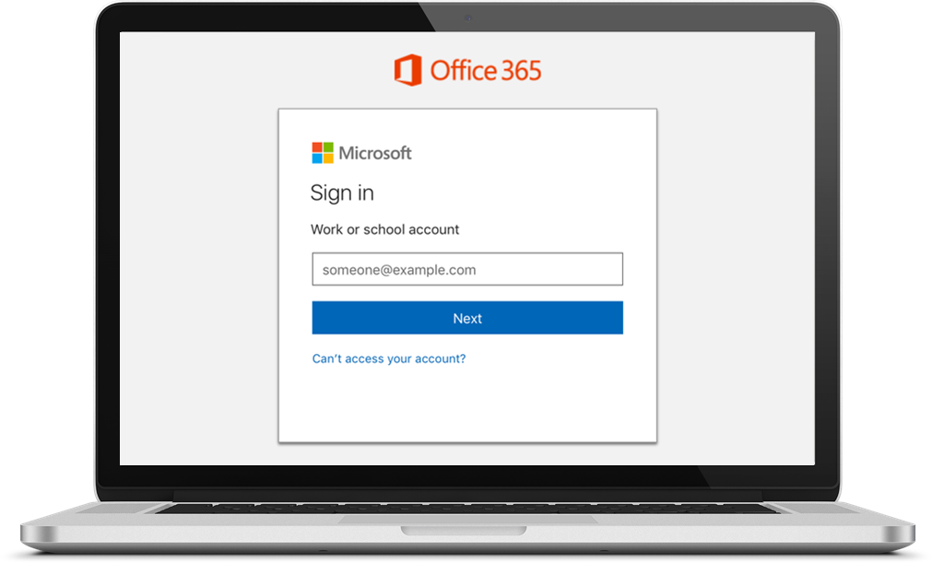
Email Compromise: Employee to Employee
From: Your Boss <yourboss@fakeyourcompany.com>
Sent: 09 October 2018 11:06
To: Your Company Finance <finance@yourcompany.com>
Subject: IMPORTANT: Fund Transfer Done Today
Hi Gwen,
Could you do me a favor? There’s a pending invoice from one of our providers and because I’m on holiday I need you to take care of it for me because I can’t access the accounts from here.
They contacted me and I told them to send through the email to you as well (check spam filter incase it’s accidentally blocked!)
Just click on the link in their email and transfer the amount to the account they specify.
This needs to be done TODAY so make it high priority.
If you could do this for me it would be a huge favor.
Any questions then reply to this email. I can’t take calls right now so just stick to replying to this email.
Thanks,
Your Boss
TA targeting a subordinate—common tactic to pray on a person’s willingness to please a superior
Separate email sent with malicious link
Urgent request—common tactic
Sender can’t be reached—common tactic
Notes:
-Sample fictitious email coming from someone purporting to be someone’s boss (someone pretending to be an employee intending to mislead an actual employee)
-boss’ email in this example has been compromised
-boss trying to get subordinate to quickly pay a bill that probably will be followed up with either new bank routing information OR might include a link or attachment that is malware laden
-Common themes that we see:
A) person of importance making request
B) request needs to be done quickly (urgent)
C) person making the request isn’t able to “discuss” the request

Slide 12
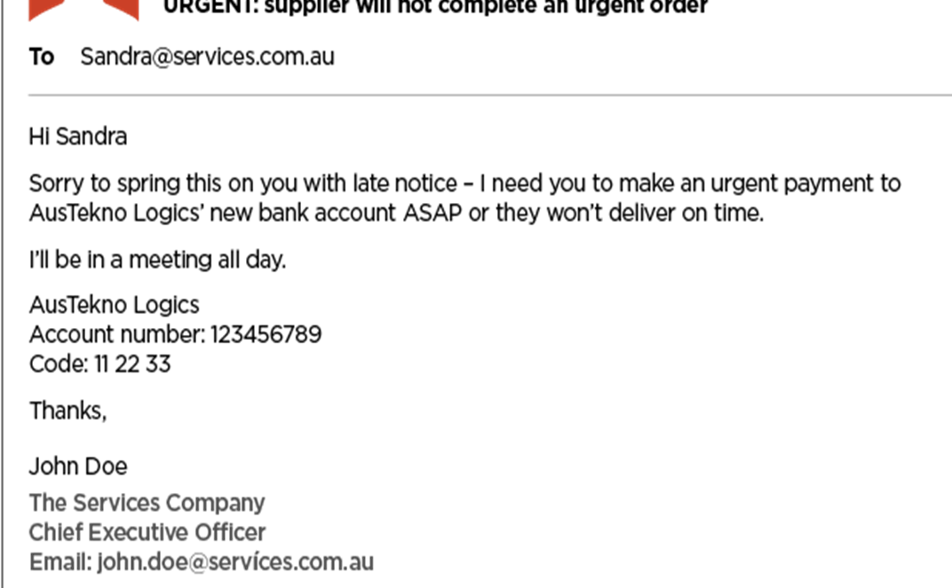
Email Compromise: Employee to Employee
TA acting as an employee to get another employee to change vendor bank information
Urgent request
Sender can’t be reached
Vendor probably IS owed money
When vendor doesn’t receive money, hack will likely be discovered
Notes:
-Here is another example of a person of influence (CEO) who had their account compromised and is attempting to pressure an employee of the company to change bant information of a vendor that is allegedly owed money and make the payment ASAP. There may or may not be an actual payment due.
-the urgency of the request, the high rank of the person making the request and the inability to question that person are all measures intended make the employee move quickly without checking the validity of the request

Slide 13

E-mail compromise LOSS PREVENTION
Require multi-factor authentication (MFA) for email & other web platforms
Train staff to look for suspicious emails
Promote culture of security awareness
Don’t just delete suspect emails—report to IT
Conduct phishing exercises on employees
Be suspicious of requests to re-enter username & password
Employ robust email filtering tools
Block or alert new auto-forwarding rules
Notes:
Require multi-factor authentication (MFA) for access to email and other web-based platforms
Train staff to look for suspicious emails
Promote culture of security awareness so employees are willing to question suspicious activity
Don’t just delete suspicious emails – report them to IT, so IT can check if others have clicked on the email
Conduct phishing exercises on employees
Be suspicious of requests to re-enter username and password
Employ robust email filtering tools/consider geo blocking
Block or alert new auto-forwarding rules

Slide 14


Slide 15
Top threats:
Ransomware

Slide 16
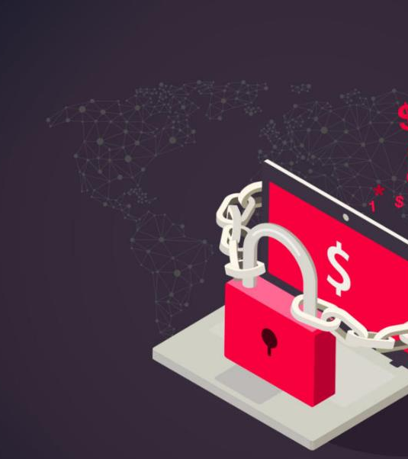
Ransomware:
Malicious software designed to block access to a computer system until money is paid
New versions are sophisticated, encrypting data and backups, propagating quickly through systems
Some versions involve element of data exfiltration
Ransom is last resort, but becoming more common
Smaller criminal groups can be troublesome to deal with: additional demands, key validity, etc.
Notes:
Malicious software designed to block access to a computer system until money is paid
New versions are sophisticated, encrypting data and backups, propagating quickly through systems
Some versions involve an element of data exfiltration. “Pay us $1,000,000 in Bitcoin to gain access to your network and so we don’t release all of your clients’ data on the internet.”
Payment of ransom is a last resort, but is becoming a more common
Smaller criminal groups can be troublesome to deal with: additional demands, key validity, etc.

Slide 17
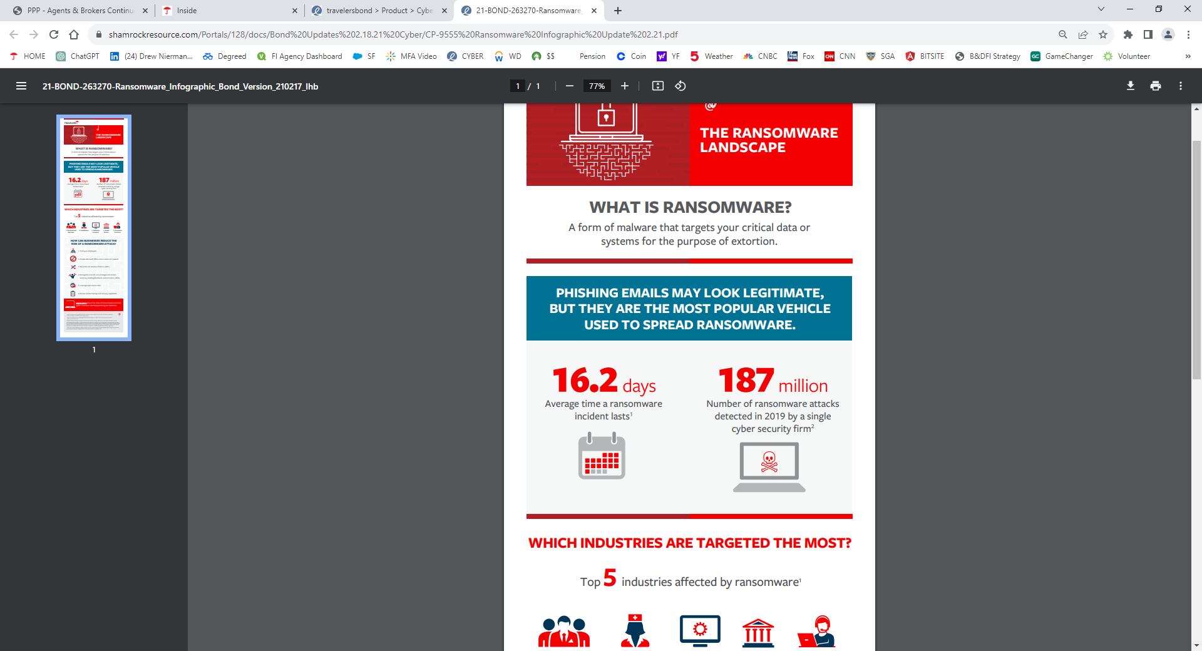
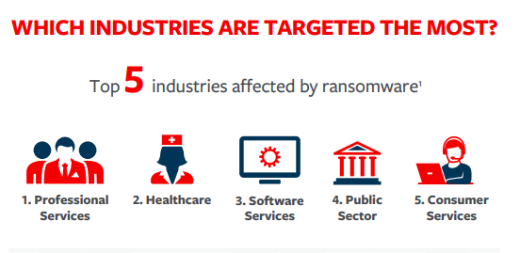
Ransomware:
Malicious software designed to block access to a computer system until money is paid
Notes:
Malicious software designed to block access to a computer system until money is paid
New versions are sophisticated, encrypting data and backups, propagating quickly through systems
Some versions involve an element of data exfiltration. “Pay us $1,000,000 in Bitcoin to gain access to your network and so we don’t release all of your clients’ data on the internet.”
Payment of ransom is a last resort, but is becoming a more common
Smaller criminal groups can be troublesome to deal with: additional demands, key validity, etc.

Slide 18





Ransomware (continues to intensify)
More TAs and evolving variants | Attacker persistence | Ransomware as a Service (RaaS)
Evolving cryptocurrencies and valuation | Ramson demand amounts increasing and groups threatening to release data | Shared computer systems
Notes:
-More Threat Actors/Evolving Variants:. Given how lucrative it can be for criminals to engage in ransomware, more and more groups (both criminal & state sponsored) are getting involved. Additionally, there has been an increase in ransomware variants over the years (Fortiguard Labs has indicated that they have seen over 10,000 different ransomware variants in the first 6 months of 2022 which was double what they had seen in 2021).
-Attacker Persistence:-Many threat actors are focused on remaining in a compromised network as long as possible and finding different ways to stay in that network without being detected or removed. This can be helpful especially for access brokers who penetrate networks and then sell access....if they can show proof that they’ve been in a network for a while they can get more money when selling.
-RaaS (Ransomware as a Service) has become very popular, allowing for more threat actors/criminals to get involved and attack companies. They can purchase the ransomware variants and in some cases even pay for support by the RaaS creators (splitting proceeds). It basically just makes it easier for less sophisticated criminal groups to enter into hacking.
-Evolving Cryptocurrencies & valuations=cryptocurrencies continue to fluctuate in prices which can make payment of ransoms (if that is done) very expensive depending on recent price trends
-Ransom demand amounts increasing and groups threatening to release data: more and more criminal groups are moving straight to data exfiltration. Once this is done, threat actors can first attempt to solicit ransom for decryption keys. If insured says “no way” , then the threat actor can demand payment..or they will dump the exfiltrated material on the dark web. We call this double extortion. Some criminal groups can become very aggressive, calling employees, customers, vendors, trading partners of compromised companies and informing them of the breach/saying that they will dump all information on dark web if ransom is not paid by compromised company
-shared computer systems-cyber attacks present serious systemic risk. Given the interconnectivity within organizations, one compromised computer or user account can potentially cause many computers/accounts to be infected. Additionally, many organization use similar software/providers/hardware and vulnerabilities in those can lead to many organizations being compromised.

Slide 19
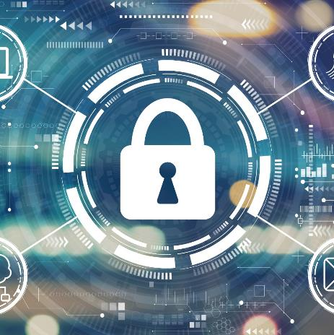
Ransomware LOSS PREVENTION
System security controls and maintenance
Secure remote connections
Be mindful of any EOL (End of Life) software/applications
Disable Microsoft Office macros via group policy
Email filtering and external email warning is very important
MFA for remote access AND administrative access
Geo-blocking can help cut down on remote connections from IP addresses outside of region
Endpoint Protection and Response (EDR)
Notes:
System security controls and maintenance
-Secure remote connections (exposing RDP to the internet with port 3389 puts a bullseye on a company. If you are going to allow RDP to connect to the internet (not advisable), use a VPN, use MFA and change the port from the default 3389.
-Disable Microsoft Office macros via group policy (ex: Excel, Word). Macros are operations that allow for a way to automate a number of processes with a single key stroke. Hackers can attach macros to word/powerpoint/excel documents and if they care clicked on by an unsuspecting user, they can infect a computer. Having corporate administrators disable macros for all unauthorized users is a way to help prevent certain types of viruses to infect networks.
-MFA for remote access AND administrative access
-Endpoint Protection and Response (EDR) — better than traditional antivirus
-Patch management is critical in any organization. Be mindful of any EOL (End of Life) software/applications
-Email filtering and external email warning is very important
-Geo-blocking can help cut down on remote connections from IP addresses outside of region (if you are a manufacturer that operates in North America and don’t have any customers, suppliers or employees in Russia, you could block any remote connection from IP addresses in that region as an example)

Slide 20
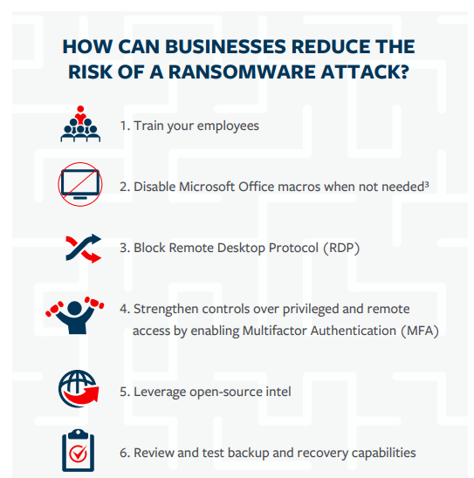
Ransomware LOSS PREVENTION
Notes:
System security controls and maintenance
-Secure remote connections (exposing RDP to the internet with port 3389 puts a bullseye on a company. If you are going to allow RDP to connect to the internet (not advisable), use a VPN, use MFA and change the port from the default 3389.
-Disable Microsoft Office macros via group policy (ex: Excel, Word). Macros are operations that allow for a way to automate a number of processes with a single key stroke. Hackers can attach macros to word/powerpoint/excel documents and if they care clicked on by an unsuspecting user, they can infect a computer. Having corporate administrators disable macros for all unauthorized users is a way to help prevent certain types of viruses to infect networks.
-MFA for remote access AND administrative access
-Endpoint Protection and Response (EDR) — better than traditional antivirus
-Patch management is critical in any organization. Be mindful of any EOL (End of Life) software/applications
-Email filtering and external email warning is very important
-Geo-blocking can help cut down on remote connections from IP addresses outside of region (if you are a manufacturer that operates in North America and don’t have any customers, suppliers or employees in Russia, you could block any remote connection from IP addresses in that region as an example)

Slide 21
Ransomware LOSS PREVENTION
Backups
Threat intelligence sharing
Incident response/disaster recovery planning
Segregated on the network or stored offsite, and tested regularly (by restoring from backups)
Participate in groups such as US-CERT, SANS, etc.
Tabletop exercises — know what to do before you’re attacked
Engage with forensic firms with knowledge of hacker groups
  Will this group be able to deliver functioning encryption keys?
  Negotiation tactics if payment of ransom is necessary
Notes:
Backups= having backups that are either stored offline/segregated from the rest of the corporate network that can be accessed & allow a company to restore their information and corporate infrastructure allows for flexibility in the event of a ransomware attack. Having untainted, recent backups means a company has the leverage to tell a hacker to go pound sand when the ransom demand is made. It is also important that companies “practice” restoring from backups on a regular basis so that when something does happen, they can quickly start restoring from backups (we have seen companies that never tried restoring from backups and encountered issues when attacked. More on that later)
Threat Intelligence Groups: these groups are helpful for sharing information, staying up on the latest threats, networking and meeting people who can help organizations stay vigilant on cyber security
Incident Response/Disaster Recovery:
Tabletop exercises-these are “drills” that involve all relevant individuals who need to come together in the event of some sort of cyber incident. Different scenarios (lost laptop, disgruntled ex employee steals a bunch of customer data, ransomware attack etc) can be run. Facilitator (can be internal or external) works with all relevant stakeholders to walk through what everyone would do, establish action steps, timelines and what would be done to stop the attacker, restore the network, discuss legal exposures etc. Missteps or confusion during these exercises can become action items that can be honed/improved on for the next exercise. The basic premise is that organization who practice (and take the practice seriously) will be better prepared when something does happen.
Engage with forensic firms with knowledge of hacker groups.= one of the benefits to getting cyber insurance from trustworthy carriers is that they will put you in touch with very good forensic responders in the event of an incident. Outside of this, it is good to establish a relationship with firms in this space that you can vet and make sure they are of high quality so that when an incident occurs you know you’ll be getting good advice from experiences experts.

Slide 22
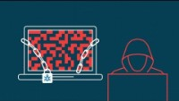

Slide 23
Top threats:
Credential theft and failure
to patch

Slide 24
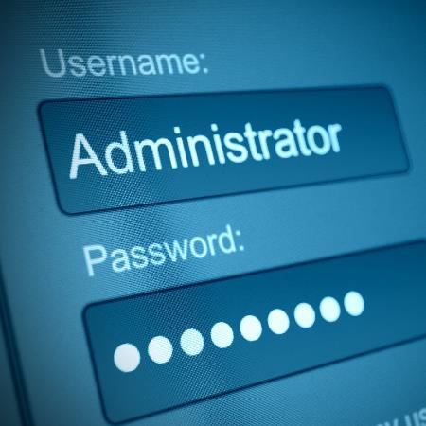
Credential theft & failure to patch
TAs frequently target individuals who have IT administrator credentials
Gaining control of an administrator’s credentials/ login information is TA’s main objective
Active directory
Administrators can do things like configure and access:
Email settings
Servers, both on premises and cloud
Anti-virus/EDR/firewalls/email filters
Patches
Backups, both on premises and cloud
Web browser settings

Slide 25
Credential theft & failure to patch LOSS PREVENTION
1
Secure the credentials of those with administrator access/privileged access
Separate account for IT work
MFA should be required
Disable “local admin” from computers
Consider using a Privileged Access Management (PAM) tool
2
Track all corporate IT assets — you need to know what you have in order to protect it
3
Regularly update/patch corporate assets with expedited process for critical patches
Most vulnerabilities had free patches available at the time the organization was attacked
Microsoft’s “Patch Tuesday” routinely includes 100+ security patches each month
Notes:
Most vulnerabilities had free patches available at the time the organization was attacked (in some cases like BlueKeep, even for unsupported products). Bitsight reported that 6 weeks after the free BlueKeep patch was offered by Microsoft, over 800,000 Windows devices were still operating without the critical patch.
Microsoft’s “Patch Tuesday,” usually the 2nd Tuesday of each month, routinely includes 100+ security patches each month.
Local Admin –You should disable local admin for users. Local admin typically is allowed for users when they first receive a computers and basically gives full security control to that computer. While this might be a good idea for your personal home PC (since you’re the sole user), corporations distributing computers need to have that disabled.

Slide 26
Important concepts

Slide 27

What is multi-factor authentication (MFA)?
Most IT professionals consider MFA one of the most important security controls that can be deployed
MFA is a critical added layer of protection
MFA is sometimes confused with VPN. VPN encrypts communications; MFA is attempting to making sure the RIGHT person is accessing or using something
MFA requires at least 2 of the following 3 factors
A username and password by itself would NOT be considered MFA
something you know
something you have
something you are
1
Two factor authentication is a form of MFA
2
Adaptive MFA and PAM are becoming more widely used
3
Notes:
MFA is a critical added layer of protection
Given the volume of malware transmitted through email, password recycling, password sharing, and other issues, most IT professionals consider MFA one of the most important security controls that can be deployed.
MFA is having at least 2 of the following 3 factors in place: something you know, something you are, and something you have.
MFA is sometimes confused with VPN. VPN encrypts communications; MFA is attempting to making sure the RIGHT person is accessing or using something.
A username and password by itself would NOT be considered MFA (a password is just a “knowledge” factor).
Two factor authentication is a form of MFA.
Adaptive MFA and PAM are becoming more widely used. Adaptive MFA is a dynamic form of MFA that, depending on the role of the user requesting to authenticate, offers additional security challenges (for example: a low level employee would be required to go through fewer steps compared to someone in IT). PAM, which stands for privileged access management, is a newer solution specifically designed to monitor & secure against credential theft (particularly of those who have administrative credentials).

Slide 28
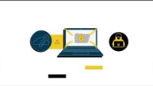

Slide 29
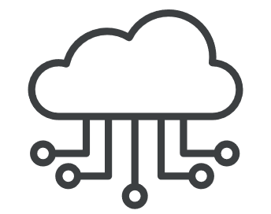
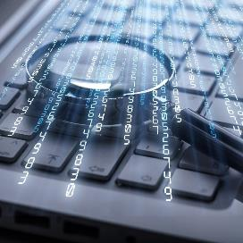
IP addresses & ports
443
Secure web browsing
There are roughly 65,000 ports
3389
Particularly enticing for criminals intent on doing harm to organizations
Closing these ports can help reduce the potential attack surface of an organization
Default RDP port
445
File & printer sharing
TAs utilize port scanning tools to search for ports that are open to internet and for unpatched vulnerabilities
Organizations should consider scanning their network to see what ports are observable and open
Notes:
What is a port? A port is a logical connection (not “physical”) that is used to by programs & services to exchange information. Ports specifically determine which program or service on a computer or server is going to be used. Each port has a unique number that identifies them. A port number is always associated with an IP address.
What is an IP address
Certain ports are known for certain things. For example, port 443 is for secure web browsing; port 3389 is the default RDP port.
Ports 3389, 445, and others are particularly enticing for criminals intent on doing harm to organizations; many organizations use them, and many exploits are available for use.
Other Port Examples: 80 is HTTP (not secure), 443 is HTTPS (secure), 25 is email.

Slide 30
What is Remote Desktop Protocol (RDP)?
RDP is a default tool included in Windows that allows for a computer (ex: laptop) to connect to a local computer (at work)
3389
RDP uses port 3389 to accomplish this connection
Local computer
Remote desktop
Remote assistance
Local computer
Many smaller organizations use this default setup given the simplicity and no additional expense
Unfortunately, it is a well-known port to all cyber criminals
The BlueKeep vulnerability (CVE-2019-0708) that caused a panic in 2019 was an RDP exploit
RDP has had numerous serious vulnerabilities over the years
While security measures can help minimize risk, closing port 3389 is the best course of action
Notes:
RDP is a default tool included in Windows that allows for a computer (ex: laptop) to connect to a local computer (at work)
RDP was not initially designed with privacy & security as the primary function, it was designed to provide an easy way to connect remotely to a corporate network.
RDP by default uses a specific port, 3389, to accomplish this connection. This port can be changed but requires effort.
Many smaller organizations used this default setup given the simplicity and no additional expense.
Unfortunately, when RDP port 3389 is open to the internet, it is essentially like shooting off fireworks for criminals and inviting their attention.
3389 is a well-known port to all cyber criminals. The BlueKeep vulnerability (CVE-2019-0708) that caused a panic in 2019 was an RDP exploit (one of many over the years to attack RDP).
RDP has had numerous serious vulnerabilities over the years
While strong passwords, using MFA, geolocation blocking, and other security measures can help minimize risk, ultimately closing port 3389 is the best course of action

Slide 31
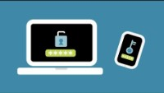

Slide 32
By-the-numbers

Slide 33
Cyber claims & incidents
Q3 2021 to Q4 2021 Coveware reported
2021 Verizon reported
2020 Microsoft stated
⬆130%
61%
99.9%
increase in ransomware payments. Additionally, Coveware reports that 84% of ransomware includes data exfiltration
of breaches attributed to leveraged credentials
of compromised accounts did not use MFA
Many cybersecurity breaches involve human error — failure to patch, misconfiguration of security applications or clicking on malicious links
Sources: https://www.coveware.com/blog/2022/2/2/law-enforcement-pressure-forces-ransomware-groups-to-refine-tactics-in-q4-2021; Verizon 2021 DBIR Report; https://www.microsoft.com/security/blog/2019/08/20/one-simple-action-you-can-take-to-prevent-99-9-percent-of-account-attacks/
Notes:
Coveware reported that the average Q4 2021 ransomware payments had risen 130% compared to Q3 2021, increasing to an average payment of $322,168 https://www.coveware.com/blog/2022/2/2/law-enforcement-pressure-forces-ransomware-groups-to-refine-tactics-in-q4-2021
Credential theft is commonly involved in cyber crime with Verizon reporting (Verizon 2020 DBIR) that nearly 80% of all hacks were a result of credential theft.
Microsoft stated that in 2020, 99.9% of compromised accounts did not use MFA (this does NOT mean that MFA can prevent 99.9% of cyber attacks)
Many cybersecurity breaches involve human error: failure to patch, misconfiguration of security applications, or clicking on malicious links
Verizon 2021 DBIR reports that 61% of breaches attributed to leveraged (stolen) credentials

Slide 34
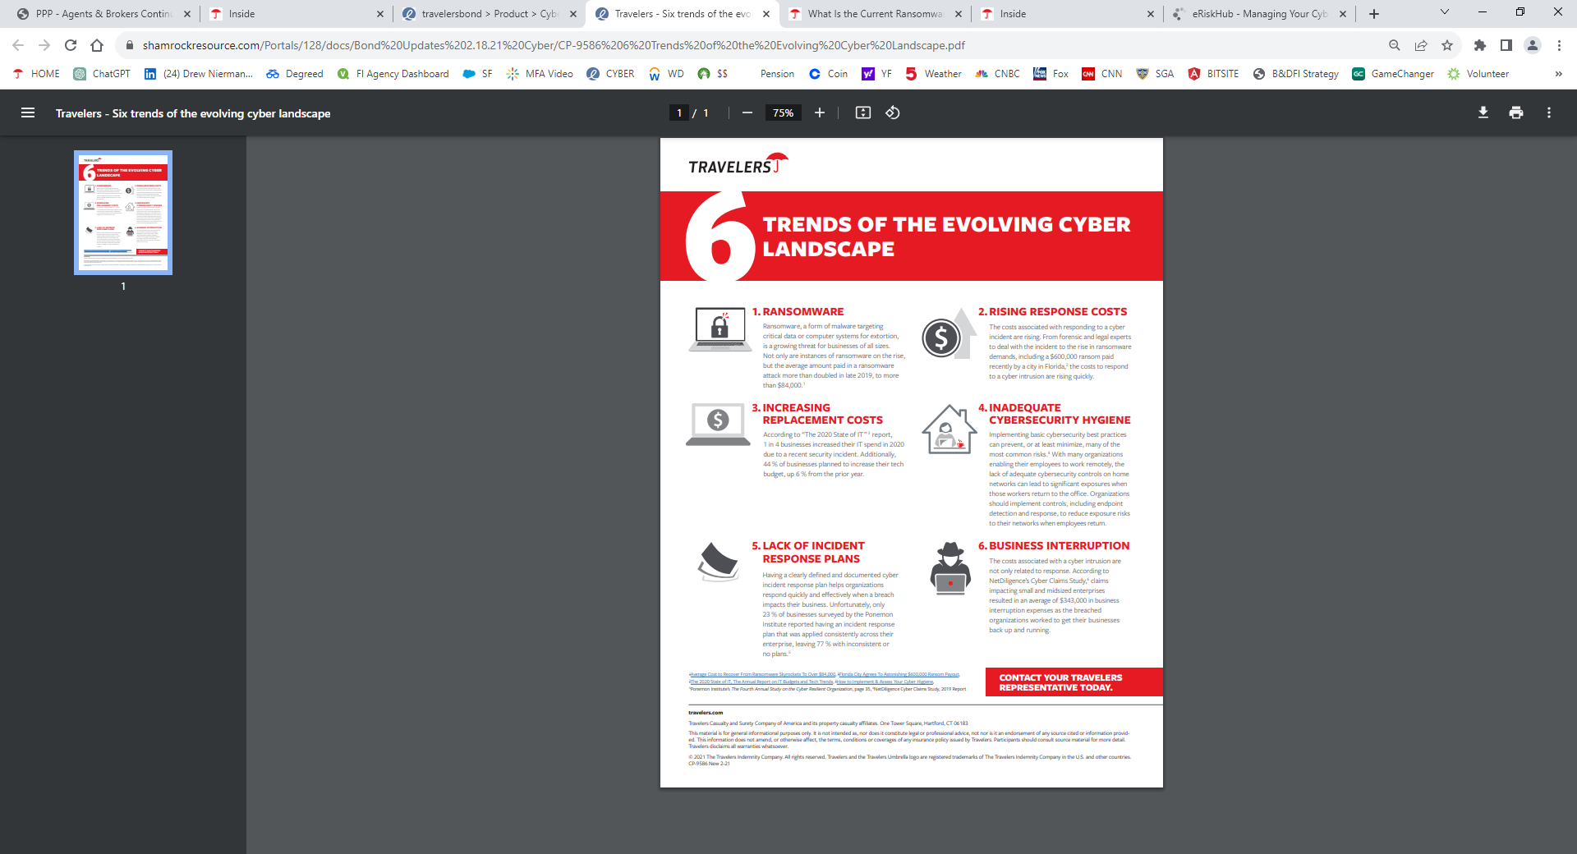
Cyber claims & incidents
Sources: https://www.coveware.com/blog/2022/2/2/law-enforcement-pressure-forces-ransomware-groups-to-refine-tactics-in-q4-2021; Verizon 2021 DBIR Report; https://www.microsoft.com/security/blog/2019/08/20/one-simple-action-you-can-take-to-prevent-99-9-percent-of-account-attacks/
Notes:
Coveware reported that the average Q4 2021 ransomware payments had risen 130% compared to Q3 2021, increasing to an average payment of $322,168 https://www.coveware.com/blog/2022/2/2/law-enforcement-pressure-forces-ransomware-groups-to-refine-tactics-in-q4-2021
Credential theft is commonly involved in cyber crime with Verizon reporting (Verizon 2020 DBIR) that nearly 80% of all hacks were a result of credential theft.
Microsoft stated that in 2020, 99.9% of compromised accounts did not use MFA (this does NOT mean that MFA can prevent 99.9% of cyber attacks)
Many cybersecurity breaches involve human error: failure to patch, misconfiguration of security applications, or clicking on malicious links
Verizon 2021 DBIR reports that 61% of breaches attributed to leveraged (stolen) credentials

Slide 35
Cyber claim themes

Slide 36
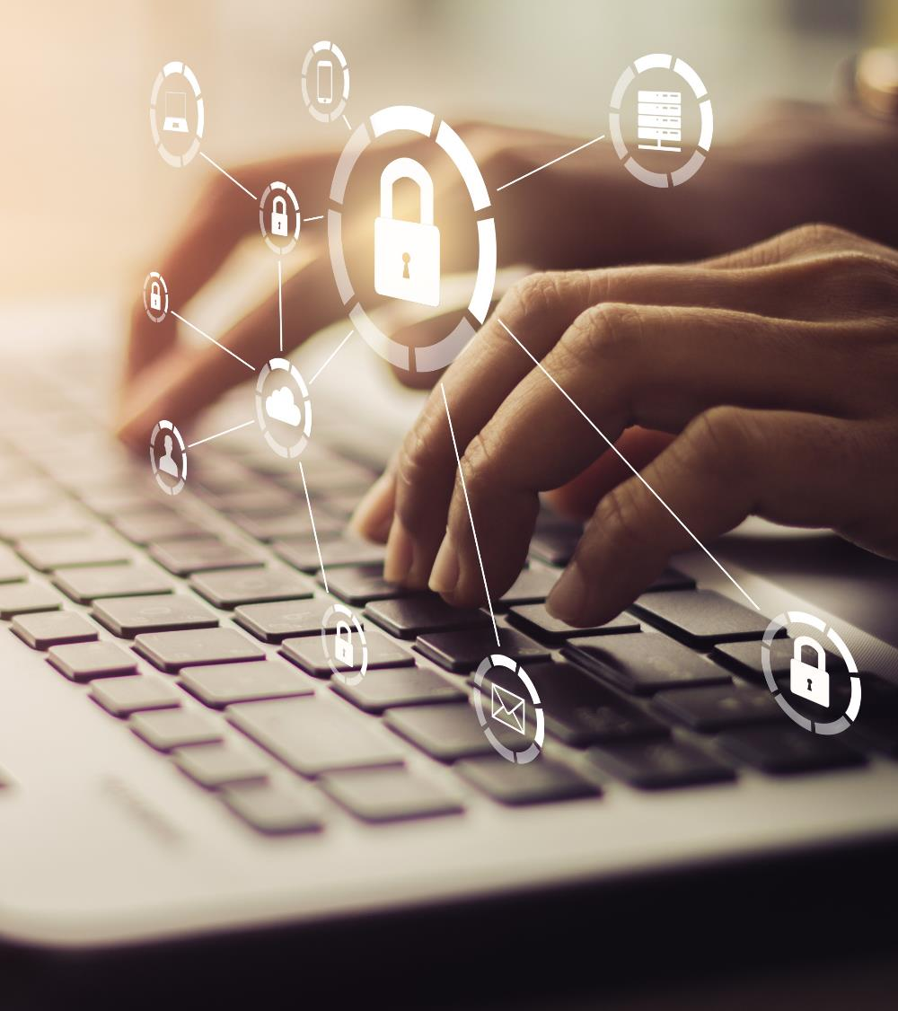
Cyber claim themes
Inadequate protection of administrator credentials (no MFA for remote or on premises, no separate administrator account)
No MFA for remote connection to environment, either cloud or premises
Improperly configured security tools
RDP port 3389 & 445 open
Organizations don’t test validity of their backups

Slide 37
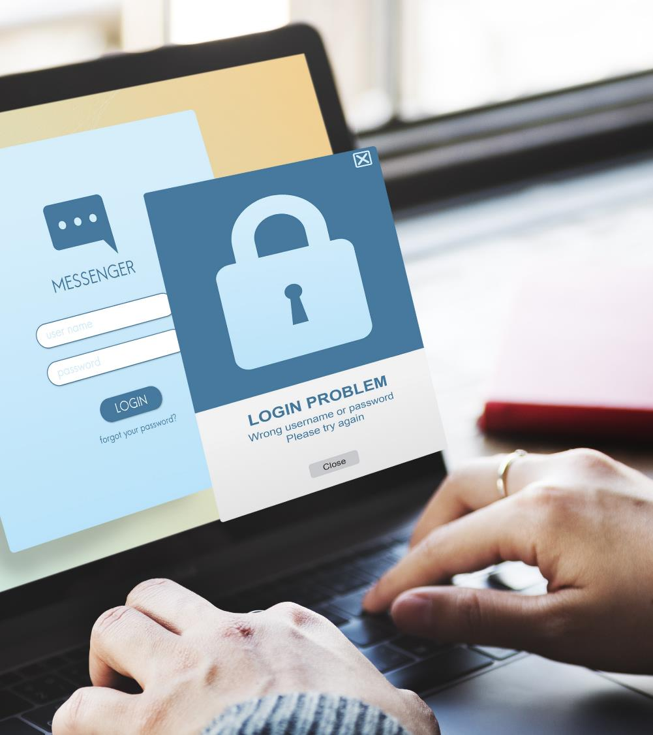
Cyber claim themes
Little or no visibility or tracking of corporate assets—EDR can help with this
Insufficient endpoint protection or email filtering
Insufficient onboarding and recurring training of employees
Unqualified or understaffed IT departments
Running End of Life (EOL) applications/hardware
Notes:
-Asset Tracking: some organizations track corporate IT assets (PCs/servers/printers/cloud assets/applications/servers etc) manually on spreadsheets. Some don’t track at all. There are also numerous software solutions from 3rd party vendors that help with asset tracking. Some EDR solutions help in the tracking of assets or can interface with asset tracking software. Asset tracking is important because if you don’t have a good grasp of your assets, it’s tough to know where things are, which assets need patching etc
-companies sometimes don’t’ spend money to have robust endpoint protection (antivirus/EDR ). Email filtering (solutions looking at inbound & outbound emails/attachments) is also something that some companies don’t utilize.
-lack of regular cyber security/privacy training is a common theme. We routinely see situations where employees are phished for login credentials or click on malicious links.
-some organizations have limited staff or have employees who are not qualified to be handling important roles (like in IT).
-Running End of Life applications/hardware. EOL applications require frequent patching which means that the older an organization’s network infrastructure, the more likely they have EOL applications/devices and that increases the chances that they miss something that needs to be patched

Slide 38
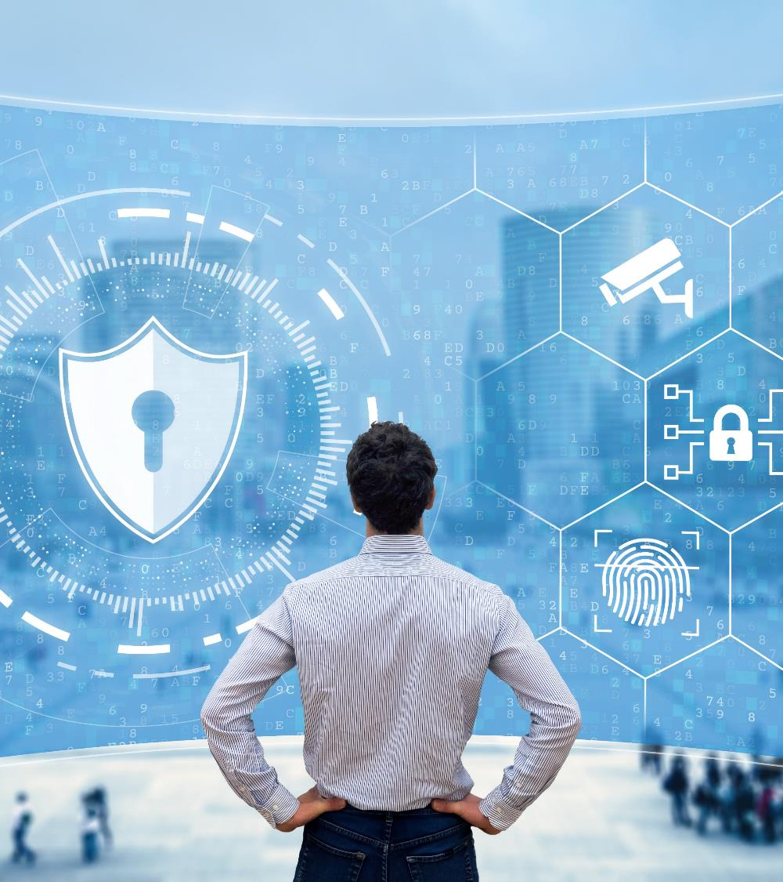
Cyber claim themes
No robust patch management procedures
No vendor management or vendor review process
Organizations not taking cyber security and integrity of their environment seriously
No established or regularly practiced incident response plan
Notes:
-some companies don’t have a regular cadence on rolling out patches, or don’t have a process in place that allows for them to have expedite updates (if there is some highly critical security patch that comes out off-cycle).
-Vendors/service providers (3rd parties) frequently have access to certain parts of an organization’s network. We have seen insureds not require MFA when those entities are connecting into the network. We have also seen vendors that are not taking appropriate steps on their end from a security/insurance perspective connect to insureds network and cause a loss. There should be a place to regularly review all 3rd parties that have access to insureds environment/make sure the appropriate controls are in place/check permissions etc.
-Organization sometimes just don’t take the integrity of their network/cyber security seriously. Not having MFA, not training employees, no IR plan, minimal asset tracking etc can all be indicators
-We routinely see companies that might have an IR plan but they haven’t looked at it and haven’t gone through any tabletop exercises (simulating some sort of cyber event) to run through exactly how all stakeholders would respond and see if improvements can be made. Companies that take cyber security seriously hope for the best but practice/anticipate the worst and regularly practicing is part of that.

Slide 39
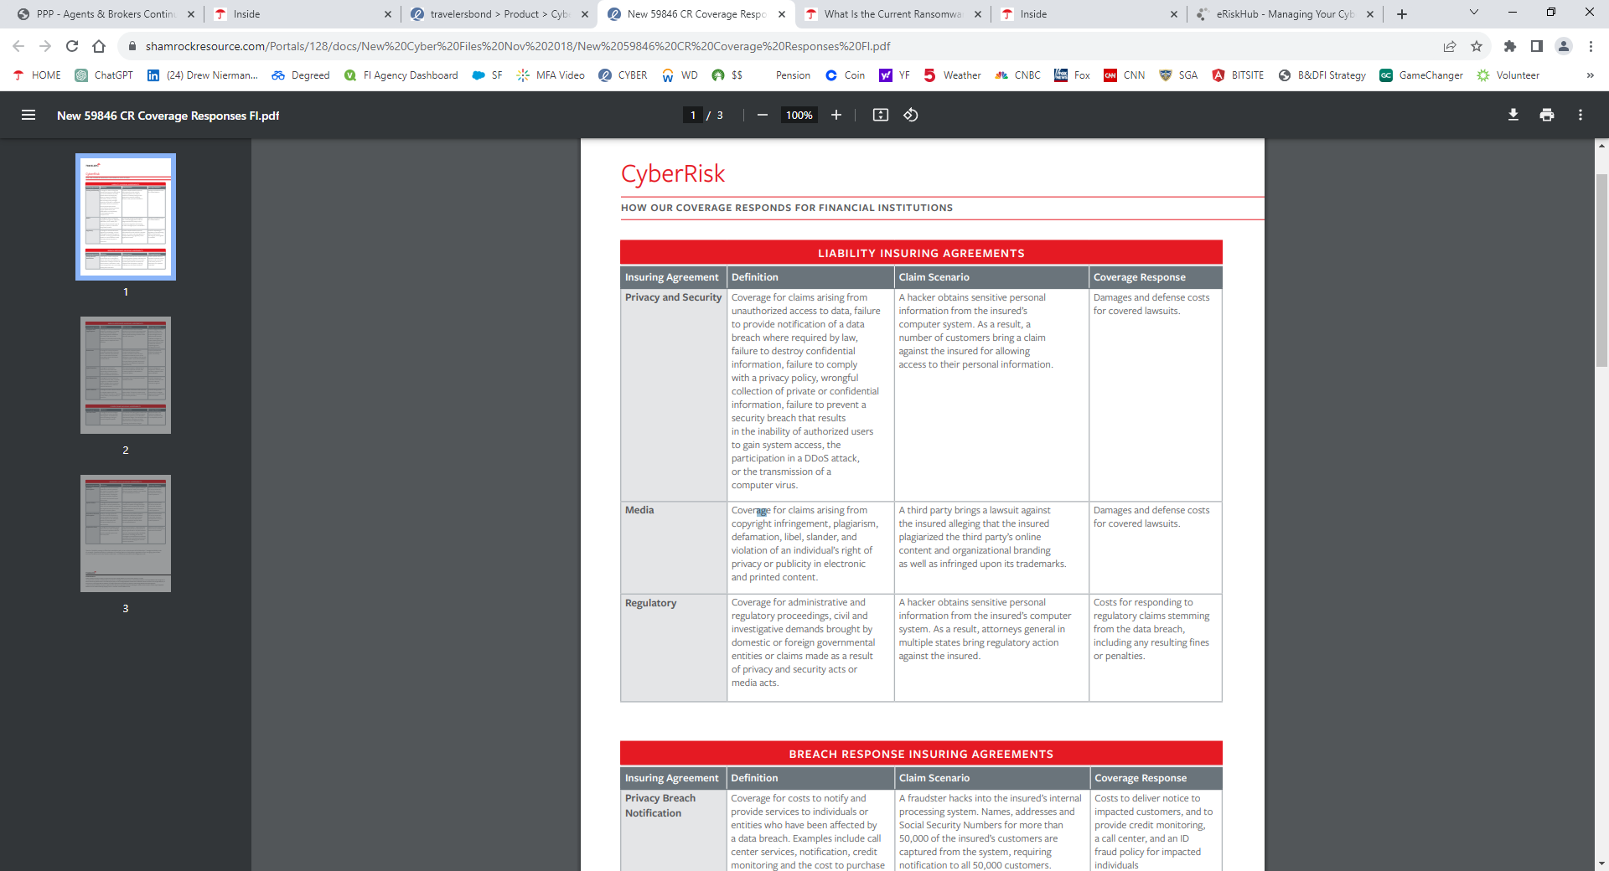
Cyber Claim- Policy Response
Notes:
-Asset Tracking: some organizations track corporate IT assets (PCs/servers/printers/cloud assets/applications/servers etc) manually on spreadsheets. Some don’t track at all. There are also numerous software solutions from 3rd party vendors that help with asset tracking. Some EDR solutions help in the tracking of assets or can interface with asset tracking software. Asset tracking is important because if you don’t have a good grasp of your assets, it’s tough to know where things are, which assets need patching etc
-companies sometimes don’t’ spend money to have robust endpoint protection (antivirus/EDR ). Email filtering (solutions looking at inbound & outbound emails/attachments) is also something that some companies don’t utilize.
-lack of regular cyber security/privacy training is a common theme. We routinely see situations where employees are phished for login credentials or click on malicious links.
-some organizations have limited staff or have employees who are not qualified to be handling important roles (like in IT).
-Running End of Life applications/hardware. EOL applications require frequent patching which means that the older an organization’s network infrastructure, the more likely they have EOL applications/devices and that increases the chances that they miss something that needs to be patched

Slide 40
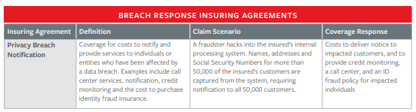
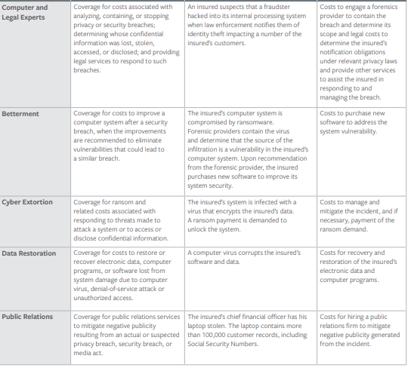
Cyber claim – Policy Response
Notes:
-some companies don’t have a regular cadence on rolling out patches, or don’t have a process in place that allows for them to have expedite updates (if there is some highly critical security patch that comes out off-cycle).
-Vendors/service providers (3rd parties) frequently have access to certain parts of an organization’s network. We have seen insureds not require MFA when those entities are connecting into the network. We have also seen vendors that are not taking appropriate steps on their end from a security/insurance perspective connect to insureds network and cause a loss. There should be a place to regularly review all 3rd parties that have access to insureds environment/make sure the appropriate controls are in place/check permissions etc.
-Organization sometimes just don’t take the integrity of their network/cyber security seriously. Not having MFA, not training employees, no IR plan, minimal asset tracking etc can all be indicators
-We routinely see companies that might have an IR plan but they haven’t looked at it and haven’t gone through any tabletop exercises (simulating some sort of cyber event) to run through exactly how all stakeholders would respond and see if improvements can be made. Companies that take cyber security seriously hope for the best but practice/anticipate the worst and regularly practicing is part of that.

Slide 41
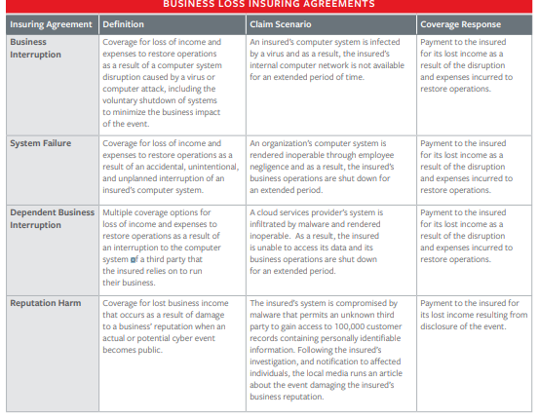
Cyber Claim- Policy Response
Notes:
-Asset Tracking: some organizations track corporate IT assets (PCs/servers/printers/cloud assets/applications/servers etc) manually on spreadsheets. Some don’t track at all. There are also numerous software solutions from 3rd party vendors that help with asset tracking. Some EDR solutions help in the tracking of assets or can interface with asset tracking software. Asset tracking is important because if you don’t have a good grasp of your assets, it’s tough to know where things are, which assets need patching etc
-companies sometimes don’t’ spend money to have robust endpoint protection (antivirus/EDR ). Email filtering (solutions looking at inbound & outbound emails/attachments) is also something that some companies don’t utilize.
-lack of regular cyber security/privacy training is a common theme. We routinely see situations where employees are phished for login credentials or click on malicious links.
-some organizations have limited staff or have employees who are not qualified to be handling important roles (like in IT).
-Running End of Life applications/hardware. EOL applications require frequent patching which means that the older an organization’s network infrastructure, the more likely they have EOL applications/devices and that increases the chances that they miss something that needs to be patched

Slide 42
Cyber insurance & Risk Management

Slide 43




Four areas of coverage
LIABILITY | BUSINESS LOSS | BREACH RESPONSE | CYBER CRIME
Privacy & security Media Regulatory | Business interruption Dependent business interruption System failure Reputation harm | Privacy breach notification Computer & legal experts Public relations Cyber extortion Data restoration | Computer fraud Funds transfer fraud Social engineering fraud Telecom fraud
Notes:
Key Message
The new Cyber form contains the same third and first party insuring agreement structure of the previous policy
Third party coverages respond when an outside entity is bringing a claim against the Insured (Privacy & Security, Media & Regulatory)
First party coverages are broken into three categories: Breach Response, Business Loss, and Cyber Crime
Policies are generally subject to an aggregate limit
Policies are generally subject to some sort of retention
Sometimes various insuring agreements can be sub-limited (this depends on the carrier & insuring agreement)
Sometimes companies will not purchase Media coverage on their Cyber policy and instead will look for this coverage elsewhere (example: an Errors & Omissions policy). It depends on the company & risk.

Slide 44

Why buy cyber insurance?
Breach coach can help quickly establish a plan of action
Most carriers offer risk mitigation tools & information
With Pay on Behalf language, insurance helps minimize the financial strain of having to potentially shell out significant amounts of money in a short amount of time
Breach Coach helps guide insured & performs critical services
Forensic review of network/environment can lead to improvements in overall security
Notes:
In the event of a breach, time is of the essence and Breach Coach & Claim can help to quickly establish plan of action
Most carriers offer risk mitigation tools & information
With Pay on Behalf language, insurance helps minimize the financial strain of having to potentially shell out significant amounts of money in a short amount of time
Breach Coach helps to guide insured through a stressful time and performs many critical services like running an OFAC check, coordinating with other providers and scrutinizing whether notification or other regulatory issues need to be considered.
Forensic review of network/environment can lead to improvements in overall security-forensic responders can make recommendations for insureds to make to improve their overall security posture/controls.

Slide 45
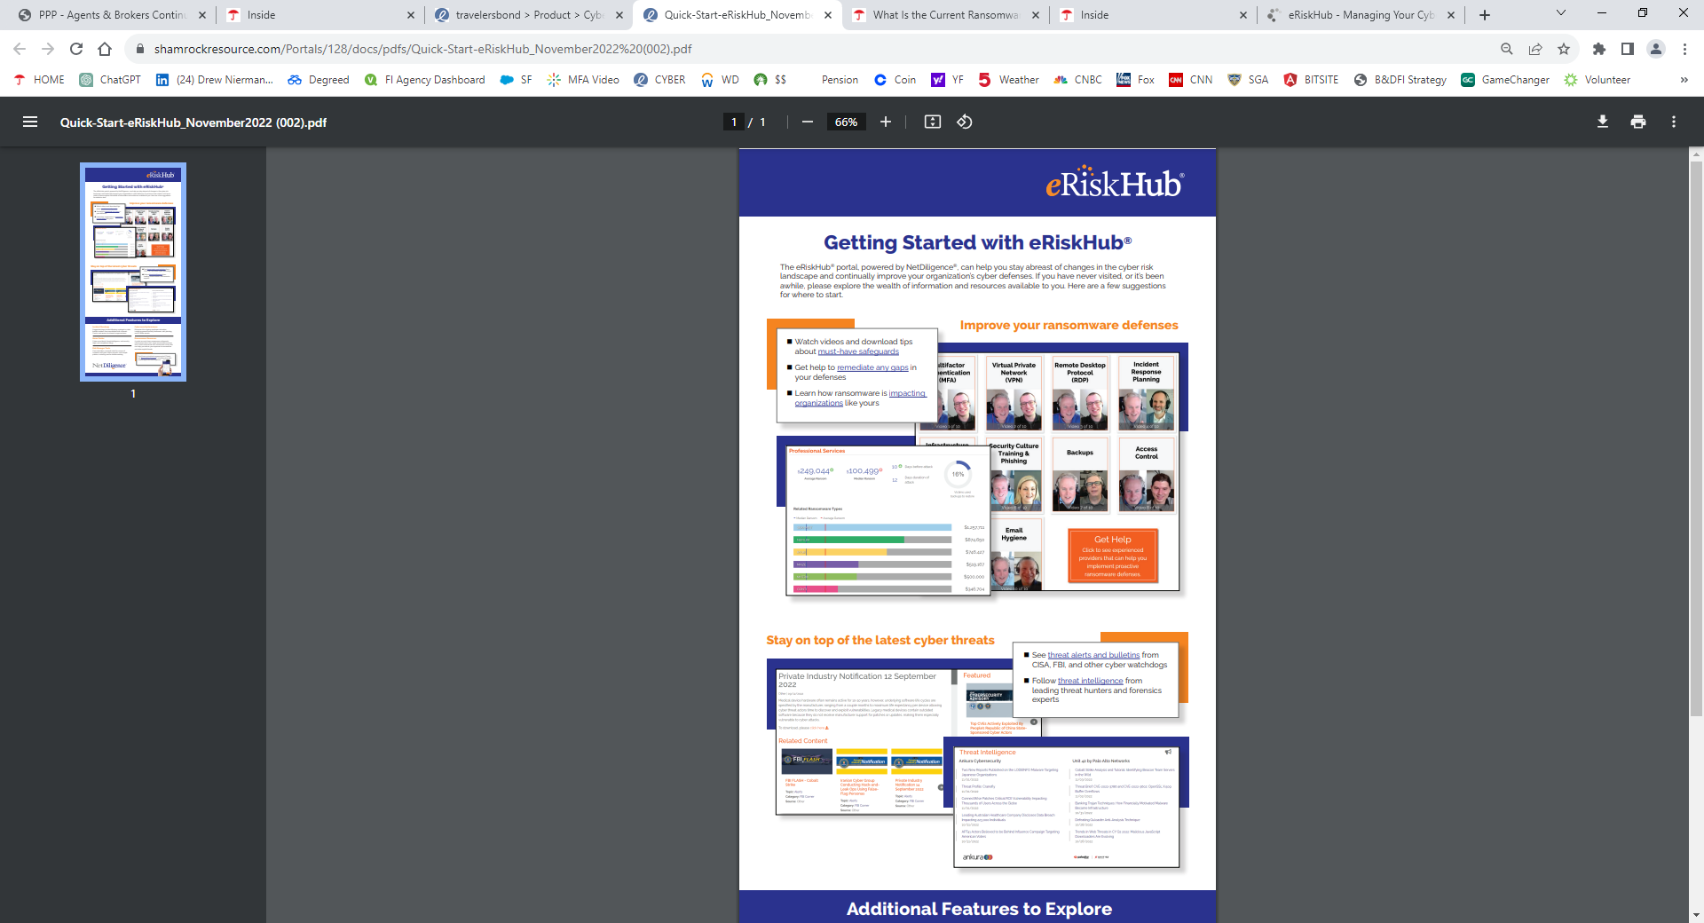
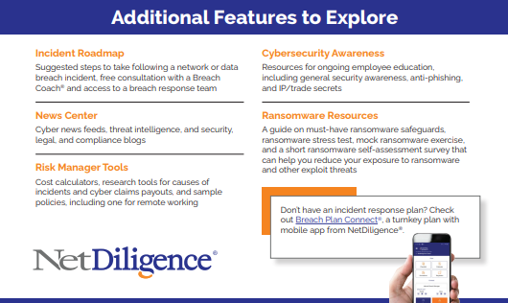
Risk Management Services – eRiskHub & Demo
https://eriskhub.com/home
Notes:
Key Message
The new Cyber form contains the same third and first party insuring agreement structure of the previous policy
Third party coverages respond when an outside entity is bringing a claim against the Insured (Privacy & Security, Media & Regulatory)
First party coverages are broken into three categories: Breach Response, Business Loss, and Cyber Crime
Policies are generally subject to an aggregate limit
Policies are generally subject to some sort of retention
Sometimes various insuring agreements can be sub-limited (this depends on the carrier & insuring agreement)
Sometimes companies will not purchase Media coverage on their Cyber policy and instead will look for this coverage elsewhere (example: an Errors & Omissions policy). It depends on the company & risk.

Slide 46
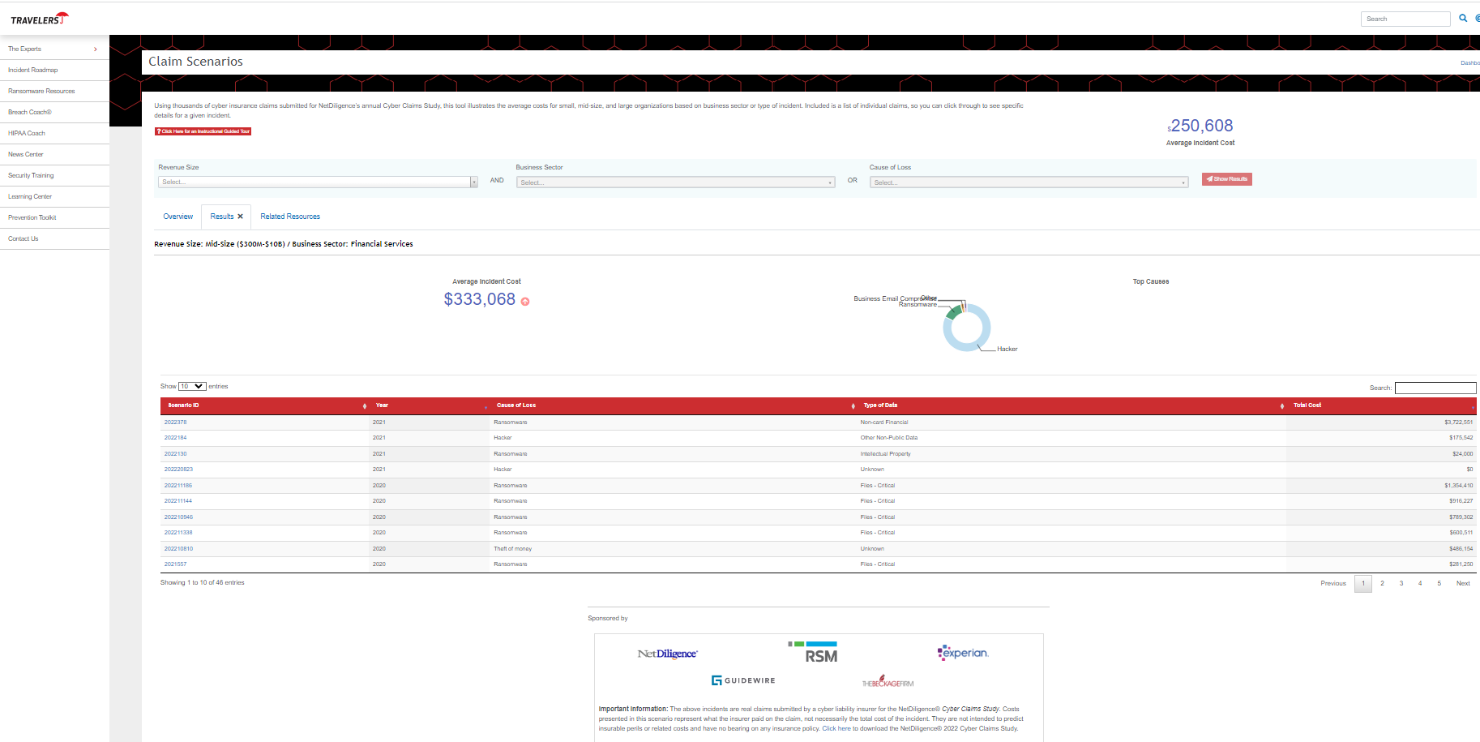
Risk Management Services – Cost Calculator
Notes:
Key Message
The new Cyber form contains the same third and first party insuring agreement structure of the previous policy
Third party coverages respond when an outside entity is bringing a claim against the Insured (Privacy & Security, Media & Regulatory)
First party coverages are broken into three categories: Breach Response, Business Loss, and Cyber Crime
Policies are generally subject to an aggregate limit
Policies are generally subject to some sort of retention
Sometimes various insuring agreements can be sub-limited (this depends on the carrier & insuring agreement)
Sometimes companies will not purchase Media coverage on their Cyber policy and instead will look for this coverage elsewhere (example: an Errors & Omissions policy). It depends on the company & risk.

Slide 47
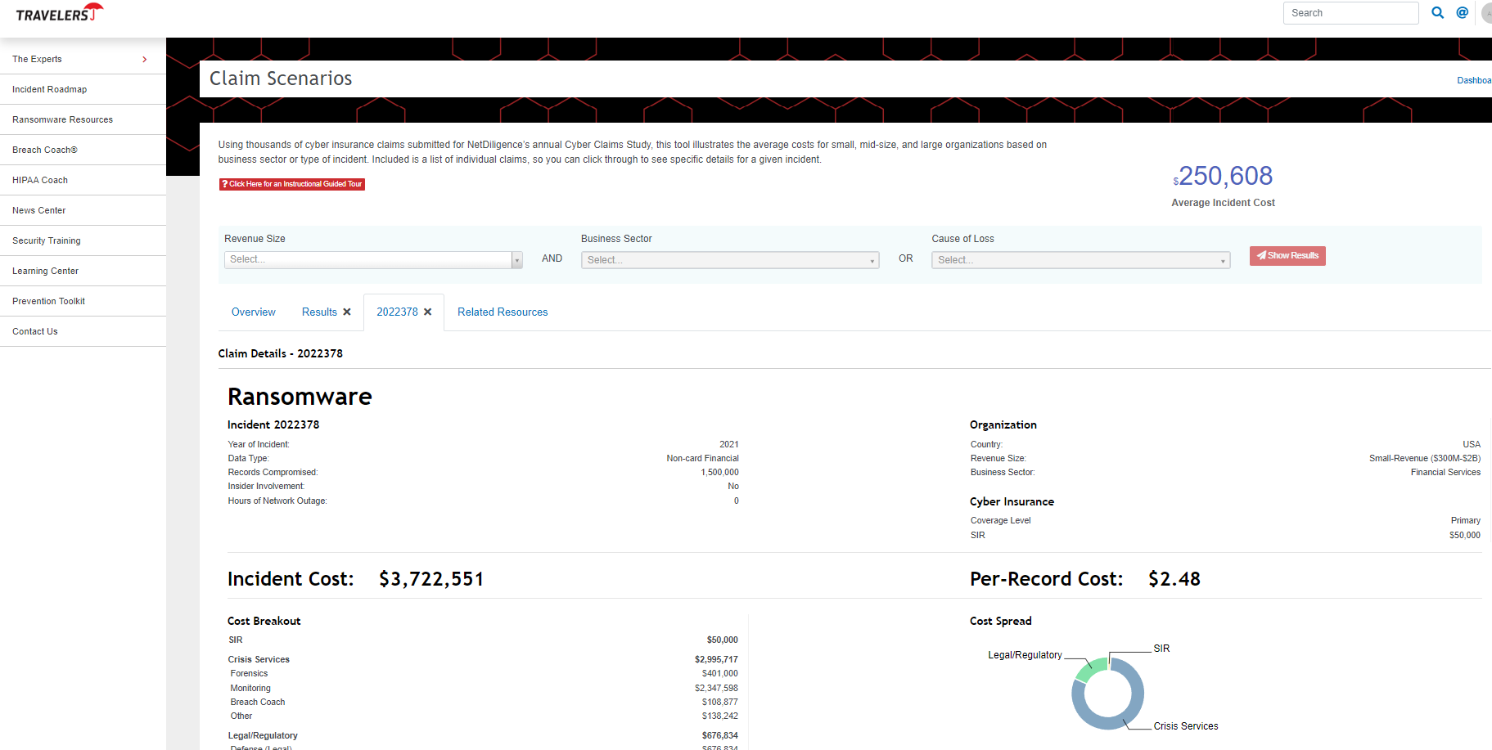
Risk Management Services – Claim Examples
Notes:
Key Message
The new Cyber form contains the same third and first party insuring agreement structure of the previous policy
Third party coverages respond when an outside entity is bringing a claim against the Insured (Privacy & Security, Media & Regulatory)
First party coverages are broken into three categories: Breach Response, Business Loss, and Cyber Crime
Policies are generally subject to an aggregate limit
Policies are generally subject to some sort of retention
Sometimes various insuring agreements can be sub-limited (this depends on the carrier & insuring agreement)
Sometimes companies will not purchase Media coverage on their Cyber policy and instead will look for this coverage elsewhere (example: an Errors & Omissions policy). It depends on the company & risk.

Slide 48

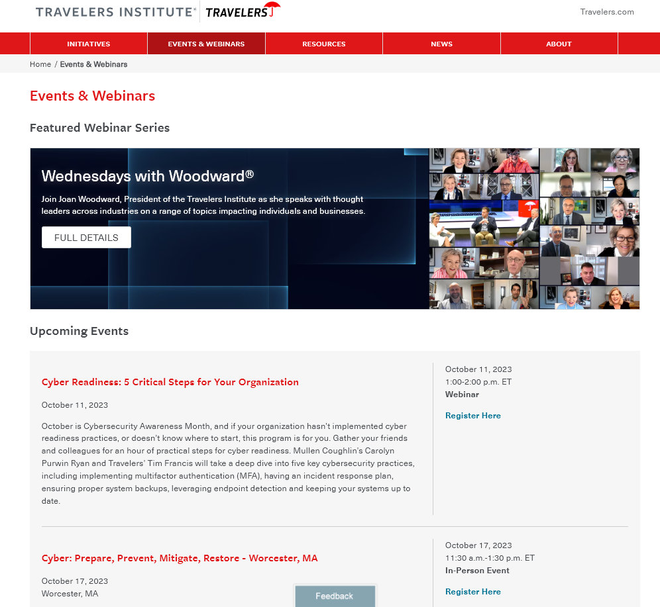
Travelers Institute – Wednesdays with Woodard

Slide 49
Questions

